Slide 1
G120 Intelligent Operator Panel
Commissioning, Programming and Diagnostics

Slide 2
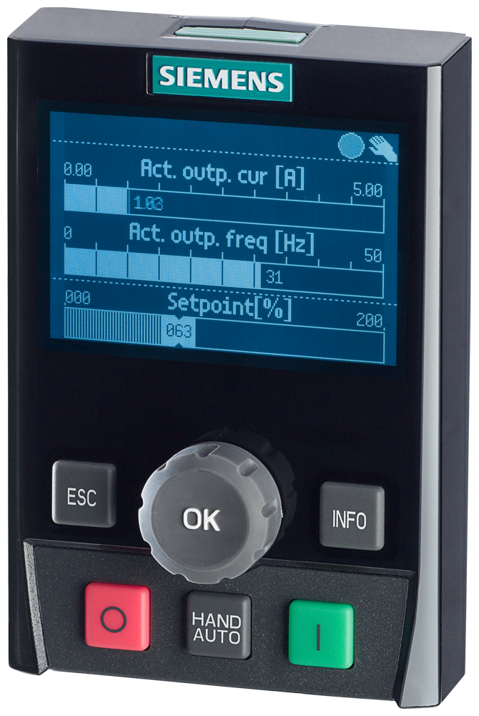
Intelligent Operator Panel (IOP)
Welcome…
This lab is designed to give you an introduction to using the Intelligent Operator Panel (IOP) for commissioning and programming a SINAMICS G120 drive. You’ll also be introduced to some of the diagnostic tools of the IOP.

Slide 3
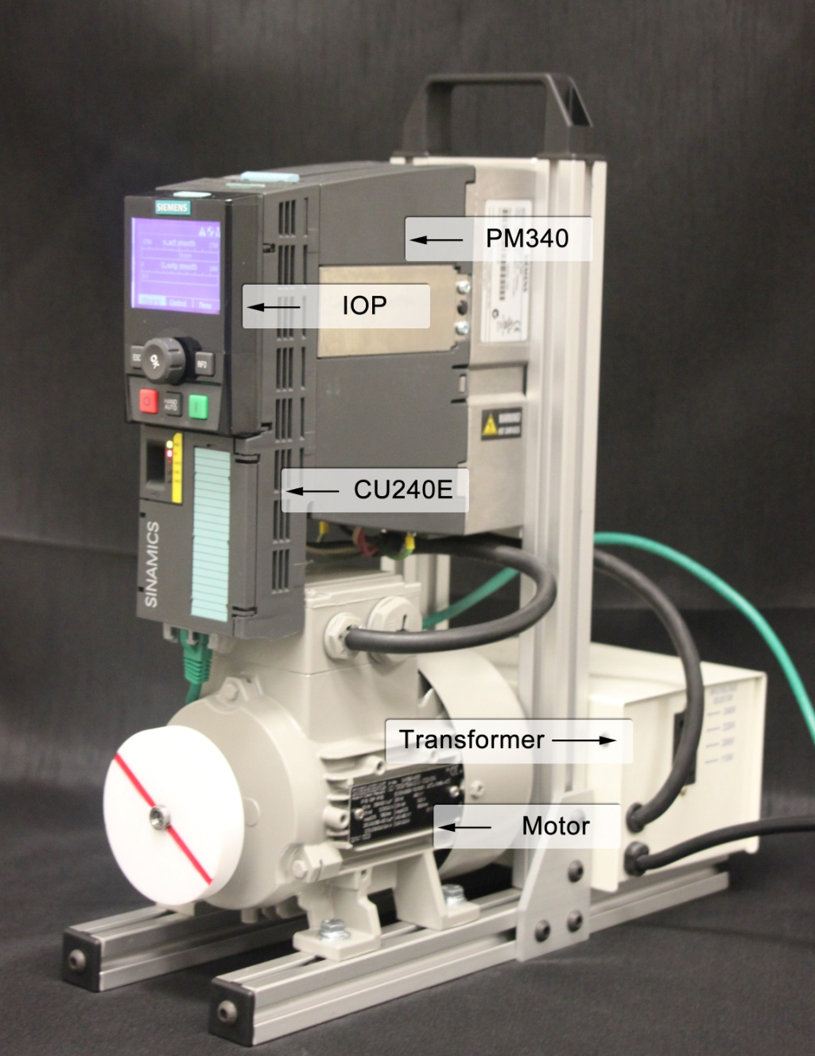
G120 Demo Unit
IOP
-Intelligent Operator Panel
CU240E-PN
-Profinet Control Unit
PM340
-230v Power Module
1LA7 Motor
-3ph 230v
Step Up Transformer
-110 to 220 1ph

Slide 4
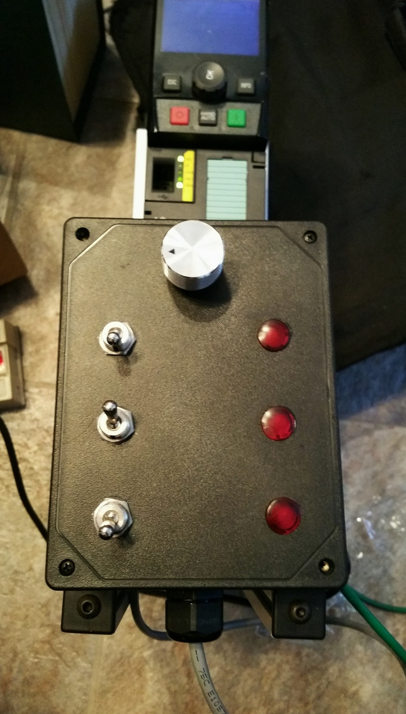
G120 IO Simulator Unit
Analog input
Digital outputs
Digital inputs

Slide 5
Intelligent Operator Panel (IOP)
Lab Outline
  IOP Features
  User Interface
    Status screen
    Status icons
    Buttons
  Exercises
    Commissioning
    Operate drive
    Backlight duration
    Diagnostics
      Faults/alarms
      I/O Status
      I/O simulation
  Search function
    Deactivate fieldbus port
  Programming
  Hand/Auto
  Backup of parameters

Slide 6
Intelligent Operator Panel (IOP)
Features
Structured menus
Commissioning wizards
Plain text display
Hand/Auto button for manual control
Help text for faults and alarms
Graphical or numerical display with two process values and units
Cloning
Storage of 16 parameter sets
IP54/UL type 12 with door mounting kit
USB interface for updating firmware

Slide 7
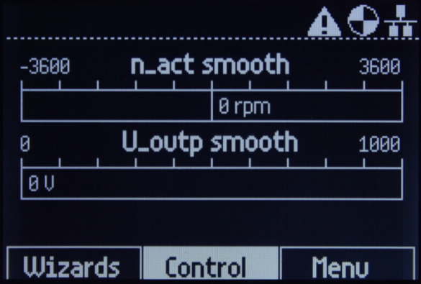
Intelligent Operator Panel (IOP)
Information: Status Screen
Before you begin programming the drive, you need to familiarize yourself with the Status screen and buttons, as well as some of the status icons.
First, let’s take a look at the Status screen as seen on the right.
Status icons appear in the top-right corner. You’ll read more about the status icons in a moment.
In the middle are two bar graphs which show the drive output speed (n_act) in RPMs and the drive output voltage. N represents speed, n_act is speed actual. This is the default configuration of the Status screen; however, it can be changed with the status screen wizard.
Across the bottom are the various menus …
  Wizards – Typically only used for initial commissioning or configuration
  Control – Used in conjunction with the HAND mode
  Menu – This is the main and most frequently used menu. You will be working in this menu throughout the lab.
Bar graphs
Icons
Menus

Slide 8
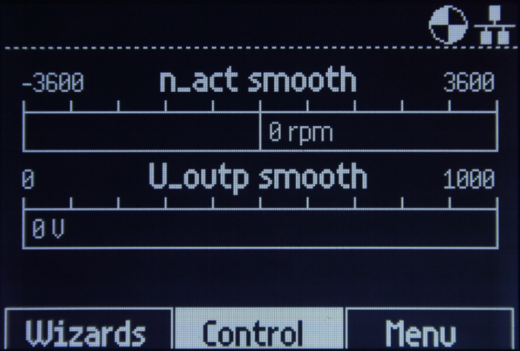
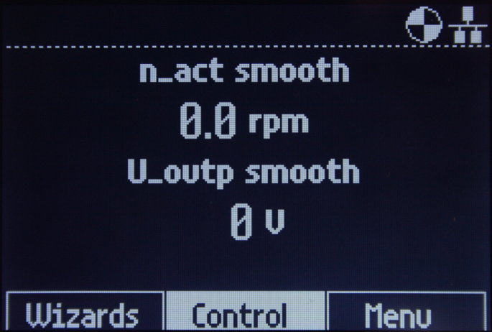
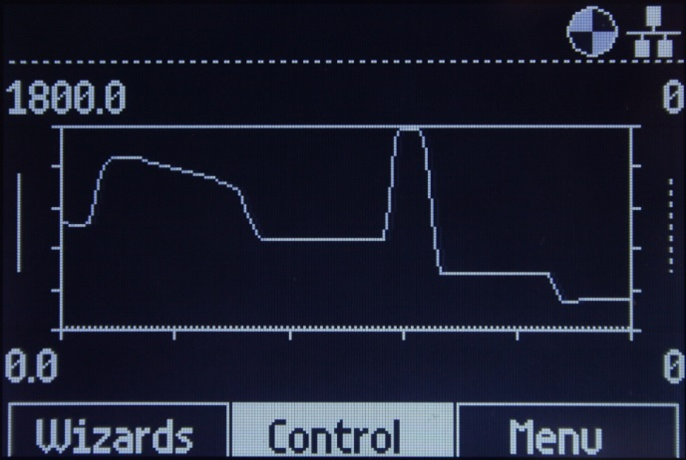
Intelligent Operator Panel (IOP)
Information: Status Screen
Here you see configuration examples of the Status screen formats. The user can select from a long list of drive values to display. Here we see the motor actual speed in RPMs and drive output voltage.
Bar Graph
Scalar Value
Trend view
Trending of motor RPMs for 2 minutes

Slide 9
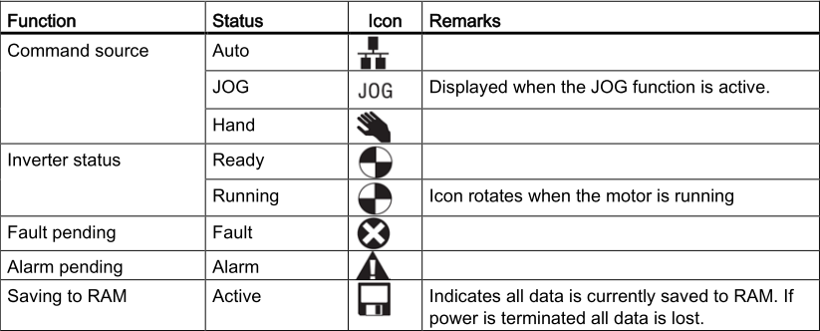
Intelligent Operator Panel (IOP)
Information: Status Icons
Take a moment to look at the status icons in the table below.
A special note about the last icon – Saving to RAM: During this lab you don’t need to be too concerned if this icon is present; however, in an actual installation the presence of this icon is an indication that parameters have been changed but NOT backed up to the drive’s ROM. A copy RAM-to-ROM should be performed to prevent the loss of parameters if a power cycle occurs.

Slide 10
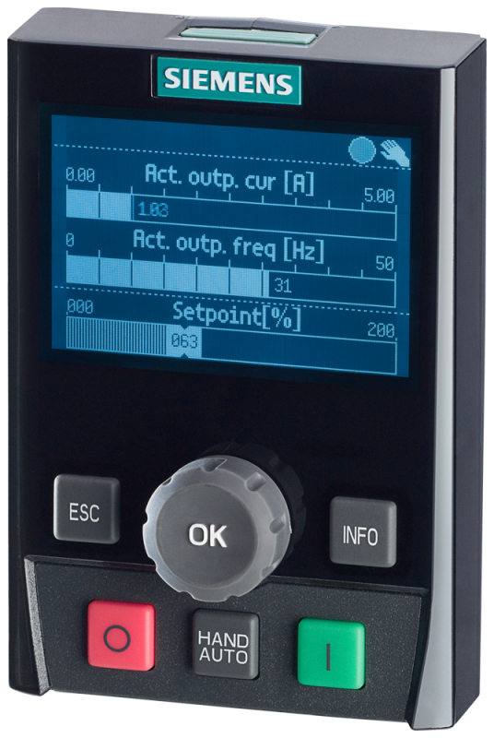
Intelligent Operator Panel (IOP)
Information: Buttons
Finally, take a few minutes to read about the functionality of the buttons. Give extra attention to the information about the ESC and OK buttons. You’ll be using them the most throughout the lab.
ESC – Used to back out of a menu or submenu. Also used to move the cursor backwards. When working in a wizard, the ESC key can be used to back up to a previous screen.
OK – (a.k.a. Rotary button or wheel) Rotates clockwise and counter-clockwise. Used to scroll the cursor up and down in menus. Used to increment and decrement values. Pressing the OK button accepts selections in menus and advances the cursor when setting values.
O (stop) – Used in HAND mode to stop the drive.
HAND / AUTO – Switches the drive between HAND mode and AUTO control. HAND is local control with the IOP. AUTO is control from an external source such as fieldbus or via the drive I/O.
I (start) – Used in HAND mode to start the drive.
INFO – Press the INFO button to turn on the backlight if the screen goes blank.
1
6
2
5
3
4

Slide 11
Intelligent Operator Panel
Start of Exercises
You are about to begin the lab exercises.
Whether modifying a value or making a selection in a menu, be mindful that the OK button is very sensitive. Each click that you feel when rotating the button is evaluated as a change. Rotate the wheel slowly and allow the screen a brief moment to update after you press the button to acknowledge or accept your selection.

Slide 12
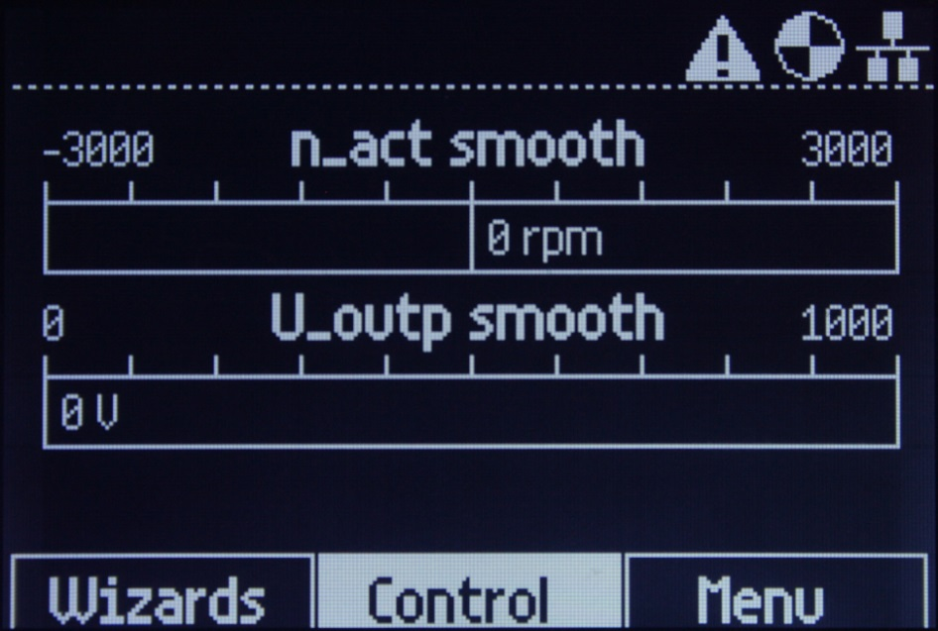
Intelligent Operator Panel
Exercise: Commissioning wizard
IMPORTANT: The first exercise will be commissioning the drive using the Basic Commissioning Wizard. Once started, the wizard will automatically advance to the next screen as you input the requested data. On some screens you will make a selection from a list; on others you will enter values. In both cases this is done by rotating the OK button (wheel) and then pressing it to acknowledge your selection. If at any time you inadvertently make the wrong selection and press the OK button, simply use the ESC button to back up to the previous screen and make your corrections.
The demo AC power should be on; however, the screen may be blank or flashing. If so, press the INFO button to turn on the screen backlight.
Your Status screen should look like the one shown here.
Continue to the next page

Slide 13
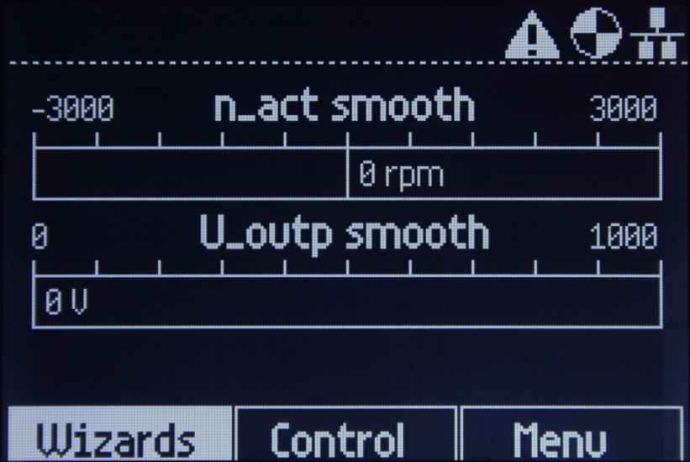
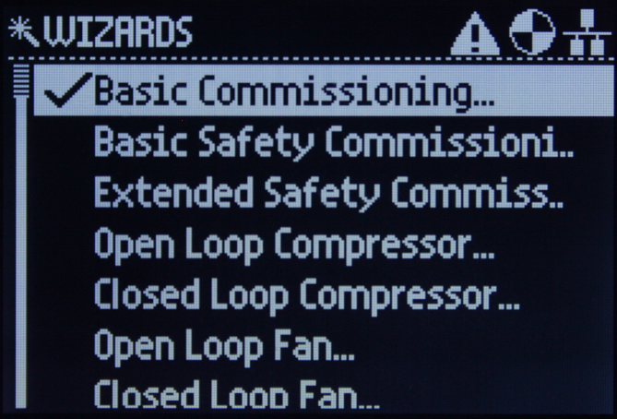
Intelligent Operator Panel
Exercise: Basic Commissioning
Using the OK wheel, rotate the wheel CCW to move the cursor to the Wizards menu. Press the OK button to select the menu.
Basic Commissioning is first in the list and already selected. Simply press the OK button to acknowledge the selection.
Continue to the next page

Slide 14
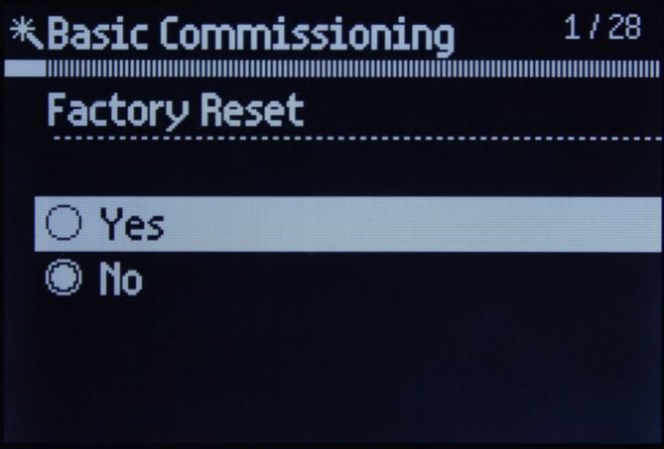
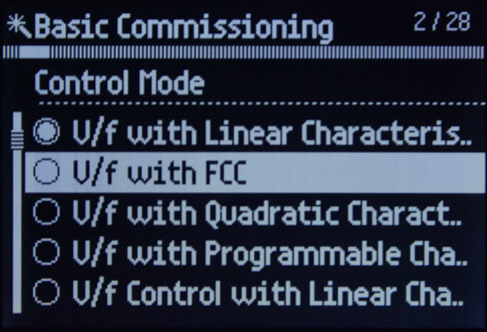
Intelligent Operator Panel
Exercise: Basic commissioning
Select Yes for the Factory Reset.
For the Control Mode select V/f with FCC. (volts/hertz with flux current control)
Don’t forget to press the OK button.
Continue to the next page

Slide 15
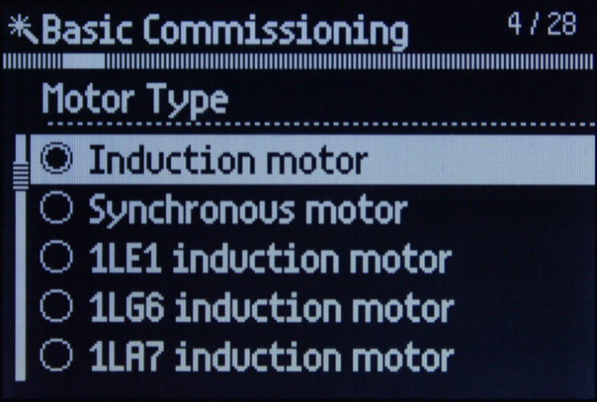
Intelligent Operator Panel
Exercise: Basic commissioning
For the Motor Type, select 1LA7 Induction motor as shown by the arrow.
Continue to the next page

Slide 16
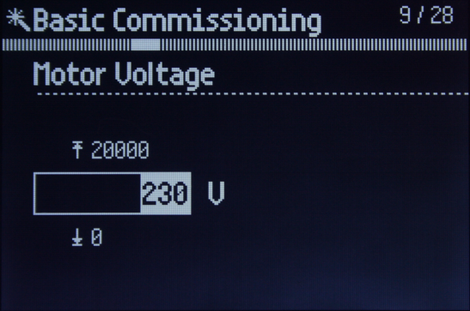
Intelligent Operator Panel
Exercise: Basic commissioning
You may have noticed that each screen has a number in the top-right corner like the one shown here for the Motor Voltage.
For screens 9 – 12, enter the values provided in the table below.
Screen no. | Screen Title | Value / Selection | Description
9 / 28 | Motor Voltage | 230 | Motor rated voltage
10 / 28 | Motor Current | 0.72 | Motor rated current
11 / 28 | Power Rating | 0.12 | Motor KW rating
12 / 28 | Motor Cos Phi | 0.77 | a.k.a. Power factor
Continue to the next page

Slide 17
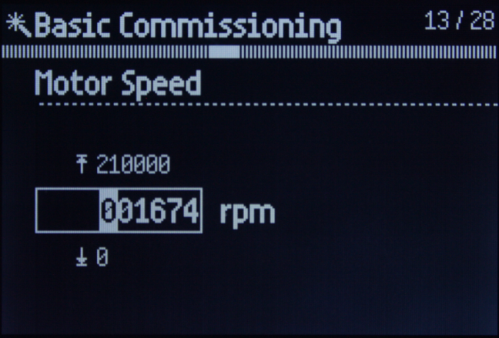
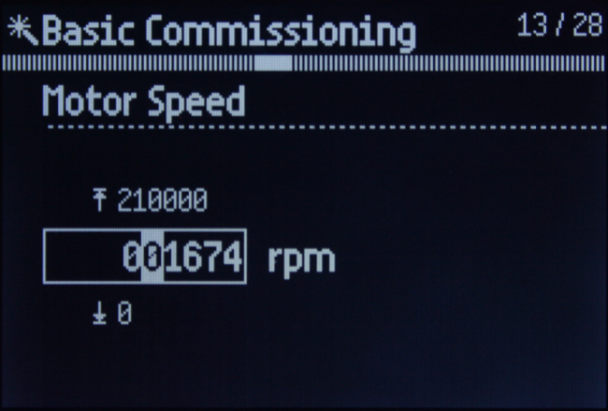
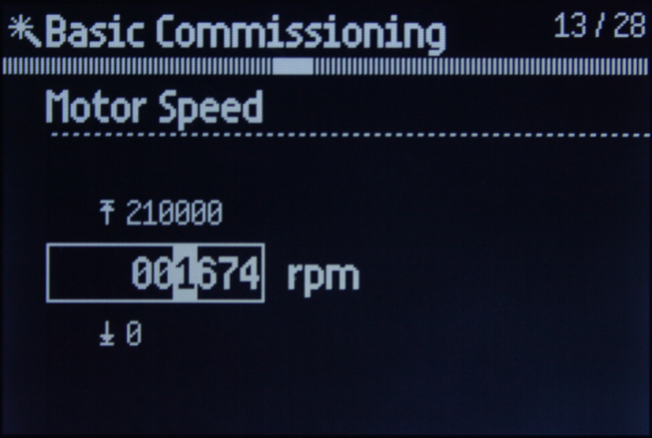
Intelligent Operator Panel
Exercise: Basic commissioning
On the previous screens, the whole number was highlighted. You simply dialed in the value with the wheel and then pressed the OK button to acknowledge (accept) the setting.
As you can see below, setting the motor RPMs is a little different. The highlighted digit indicates the position of the cursor. The OK wheel is used to dial in the desired number and then pressed to accept the value. The cursor will automatically advance to the next digit on the right. The ESC button is used to move the cursor to the left. If the cursor is on the 1s digit and the OK button is pressed, the whole number will be accepted and the wizard automatically advance to the next screen.
Study the series of screen shots below. When your ready, set the Motor Speed to 001350.
Initial screen
…after pressing OK one time
…after pressing OK again
Continue to the next page

Slide 18
Intelligent Operator Panel
Exercise: Basic commissioning
For screens 14 – 17, enter the values provided in the table below.
Screen no. | Screen Title | Value / Selection | Description
14 / 28 | Current Limit | 0.74 | Drive output current limit
15 / 28 | Motor Data Id | ID standstill | Selection of motor circuit ID
16 / 28 | Encoder Type | Continue | No data enter
17 / 28 | Encoder Pulses | Continue | No data enter
Continue to the next page

Slide 19
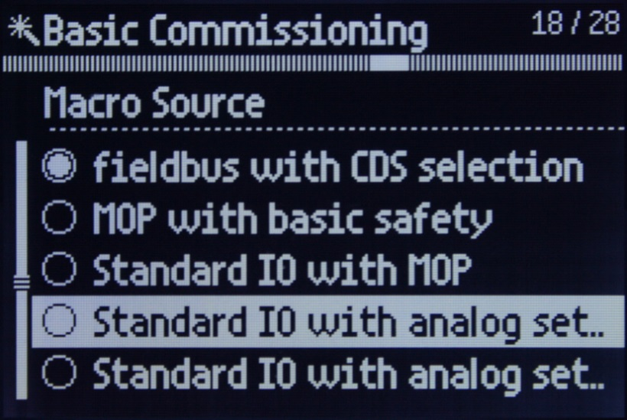
Intelligent Operator Panel
Exercise: Basic commissioning
For the Macro Source, select Standard IO with analog set … (setpoint).
Be sure to pick the first one immediately below Standard IO with MOP.
The next page has more information about the Macro Source

Slide 20
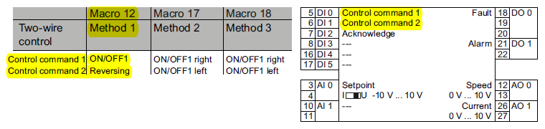
Intelligent Operator Panel
Information: Basic commissioning
Let’s take just a moment to learn more about the Macro Source.
With any drive you must determine how you will control the drive. That is, what will be the command source for start/stop and speed setpoint?
In the SINAMICS G120 drive, the command source is automatically configured based on the macro selection.
The Operating Instructions manual has the list of macros with a description and terminal block assignment.
You selected Standard IO with analog setpoint which is macro #12. The diagram below is taken from the manual which shows you that macro #12 is a two wire control method. DI0 (pin5) is the On/Off and DI1 (pin6) is the reverse command. The analog setpoint source is wired to AI0 (pins 3 & 4).
When the commissioning is complete, the demo switches will have the following assignment …
DI0(S1) = On/Off DI1(S2) = Rev (with S1 on) DI2(S3) = Fault reset AI0(POT1) = Speed setpoint

Slide 21
Intelligent Operator Panel
Exercise: Basic commissioning
For screens 19 – 23, enter the values provided in the table below.
Screen no. | Screen Title | Value / Selection | Description
19 / 28 | Minimum Speed | 0.00 | Minimum motor speed
20 / 28 | Ramp Up | 000003.00 | Ramp up time, 0 to 50 Hz.
21 / 28 | Ramp Down | 000003.00 | Ramp down time, 50 to 0 Hz
22 / 28 | Motor Temp Sensor | No sensor | I2T calculation will be performed
23 / 28 | Motor Holding Brake | Disabled (Closed) | No holding braking
Continue to the next page

Slide 22
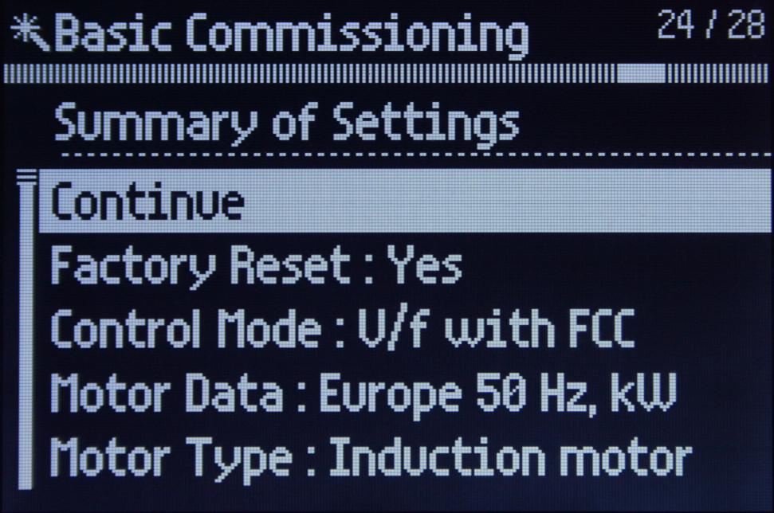
Intelligent Operator Panel
Exercise: Basic commissioning
You’re almost finished with the commissioning. The Summary of Settings gives you an opportunity to review and modify parameter values prior to finalizing the commissioning.
Here’s how it works … you can scroll down the list to review the settings. If you find a selection or value that is incorrect, place the cursor on that parameter and press OK to jump back to the step in the wizard where the value can be modified.
Take a moment to scroll down the list and review your settings, but don’t change anything unless you find an error.
When your finished reviewing the settings, place the cursor back on Continue and press OK.

Slide 23
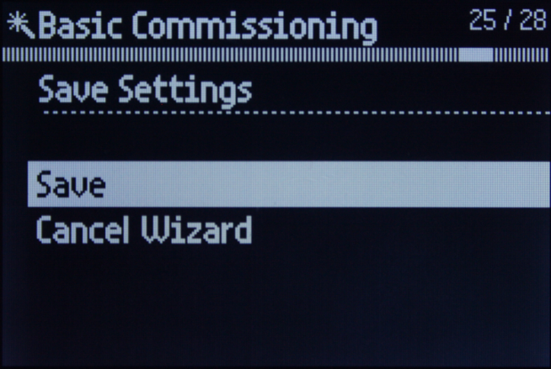
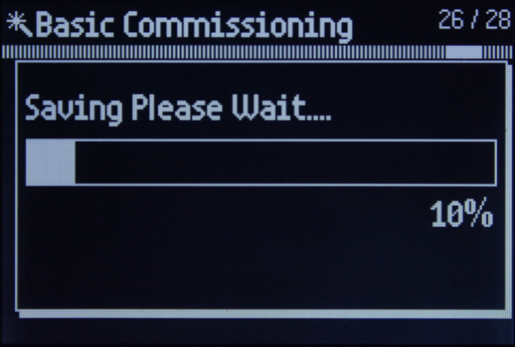
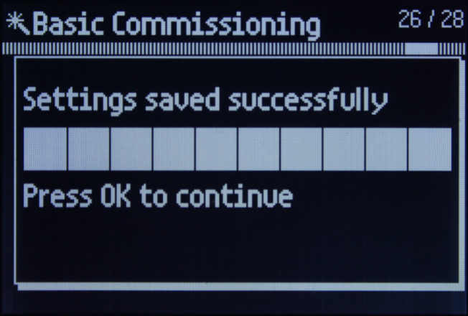
Intelligent Operator Panel
Exercise: Basic commissioning
Press OK
Continue to the next page
Press OK to save the settings
Wait for the saving to complete

Slide 24
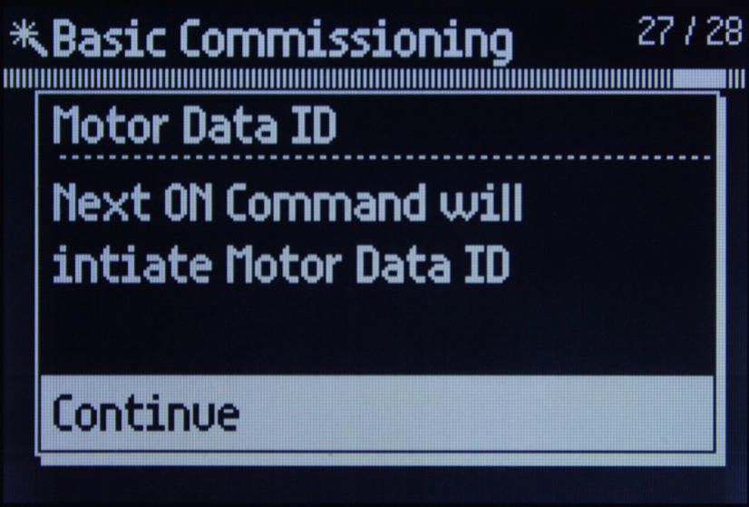
Intelligent Operator Panel
Exercise: Basic commissioning
In this step you will initiate the Motor Data ID, also called the stand-still tune. Please read the bullets below so you will know what to expect while the tuning is active.
In just a moment you will be instructed to start the drive, when you do …
You will hear the drive cooling fan running
The motor shaft might rotate ¼ turn or less
You will hear a series of high frequency rings from the motor while the Motor Data ID is in progress
Start the drive by switching S1 (DI0) ON and leave it in the ON position until the Motor Data ID has finished.
How will you know it’s finished? The drive automatically goes to an “off” state and the cooling fan stops running.
After the Motor ID has finished, set S1 (DI0) back to the OFF position, press OK and continue to the next page.

Slide 25
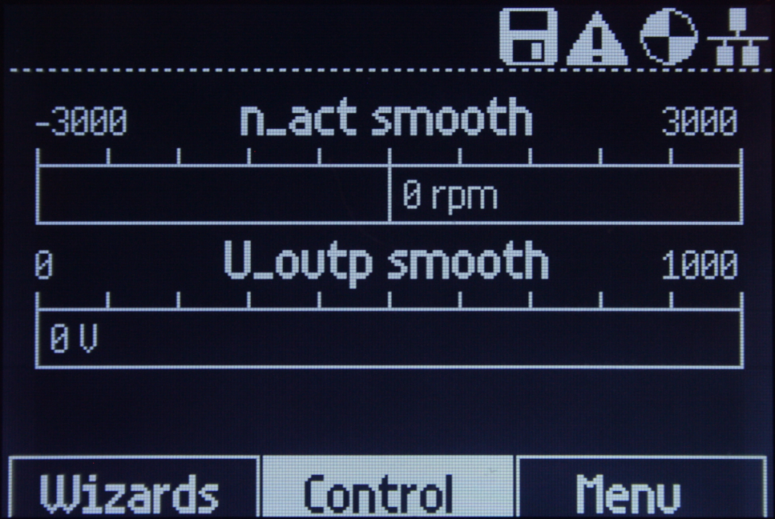
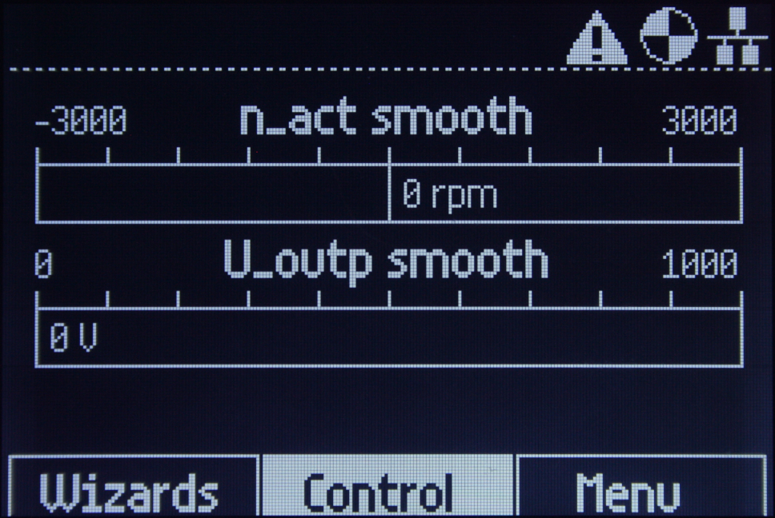
Intelligent Operator Panel
Exercise: Basic commissioning
Congratulations!
The commissioning is complete and you’re ready to operate the drive.
Continue to the next page for operating instructions.
The Save icon appears briefly because the wizard initiates a copy RAM to ROM.

Slide 26
Intelligent Operator Panel
Exercise: Drive operation
You probably noticed the alarm icon is present on the Status screen and the white lamp is on. Alarm A8526 is active because there is no PLC connected to the drive fieldbus port. You’ll clear the alarm in a later exercise, but for now spend a few minutes experimenting with the drive controls and remain in the Status screen.
See the table below for details about the switch functions and meaning of the indication lamps.
When you’re finished experimenting, switch S1 (DI0) off to stop the drive and continue to the next page.
Switch | Function | Description
S1 (DI0) | Run / Stop | Drive enable
S2 (DI1) | Reverse | Reverse with S1 on.
S3 (DI2) | Fault reset | Toggle on-off to clear fault
Pot1 (AI_0) | Speed setpoint | Setpoint, 0 – max rpm
DO_0 | Fault indication | Lamp, On = fault
DO_1 | Alarm indication | Lamp, On = alarm
DO_2 | Drive running | Lamp On = Drive running
All other switches and the analog meters are not applicable to this exercise.

Slide 27
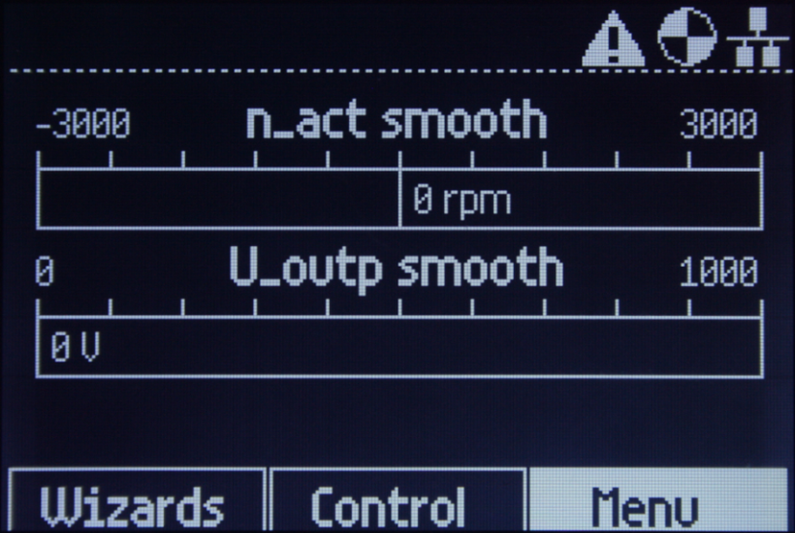
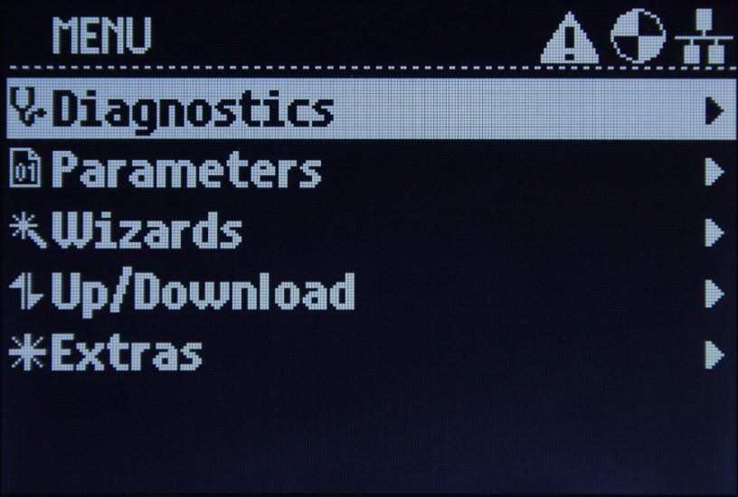
Intelligent Operator Panel
Exercise: MENU
Now let’s take a look at some of the IOP features.
Rotate the OK wheel to select Menu. Press OK to open it and view the categories.
Notice the icon at the left of each category. It serves as a visual aid when navigating in the Menu and submenus.
Watch for these icons in the remaining exercises.
Continue to the next page

Slide 28
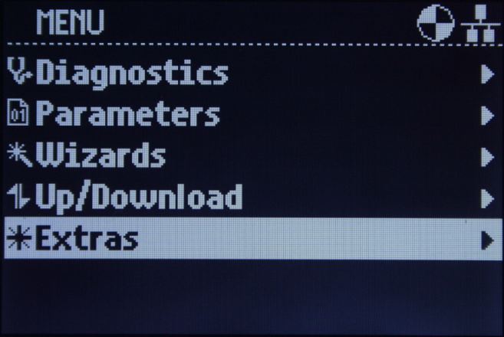
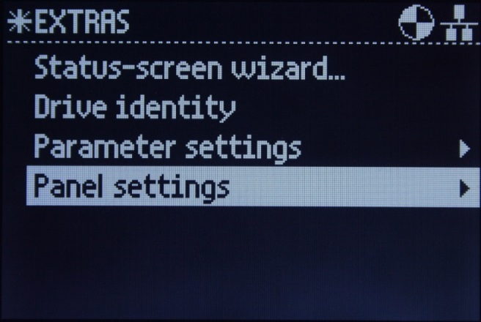
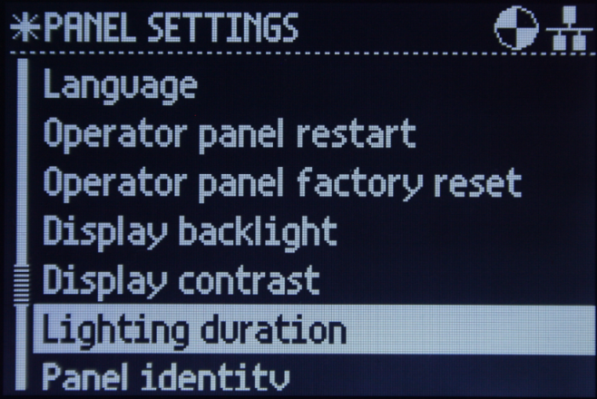
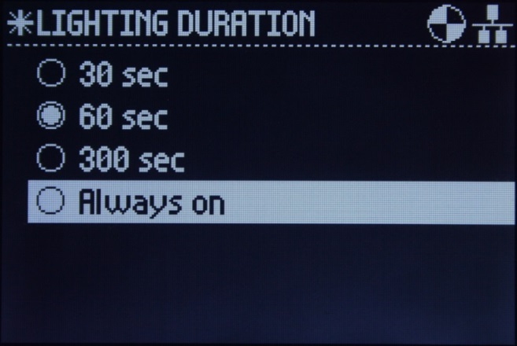
Intelligent Operator Panel
Exercise: Panel settings – Backlight duration
The first thing you’ll do is change the backlight duration. This will prevent the screen from going blank during long periods of inactivity.
Follow the pictures below and make the selections as shown. Remember to press the OK button to acknowledge your selections. After selecting the duration Always on, continue to the next page.

Slide 29

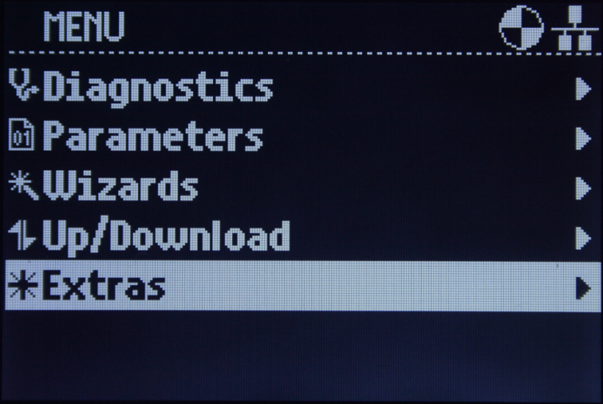
Intelligent Operator Panel
Exercise: Panel settings
On the previous page you selected Always on for the duration time. Now your screen should be back at the Panel Settings list as show in the left picture below.
Lighting duration is the only change you will make in this exercise; however, as you can see in the list there are many attributes the user can change to modify the appearance of the screen.
Feel free to take a moment to look at some of the other settings.
When your finished, use the ESC button to back up to the main MENU as shown in the picture on the right. This will prepare you for the next exercise. You may need to press ESC multiple times.
Continue to the next page

Slide 30

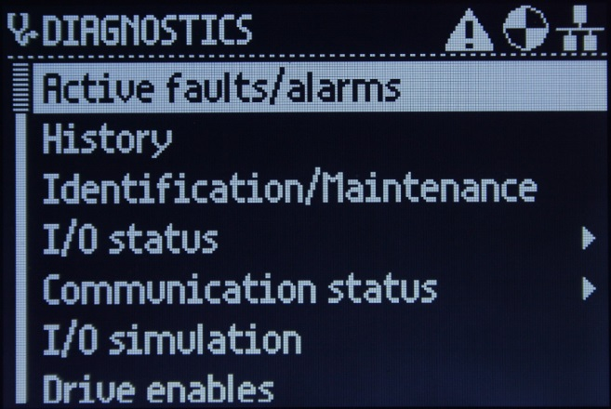
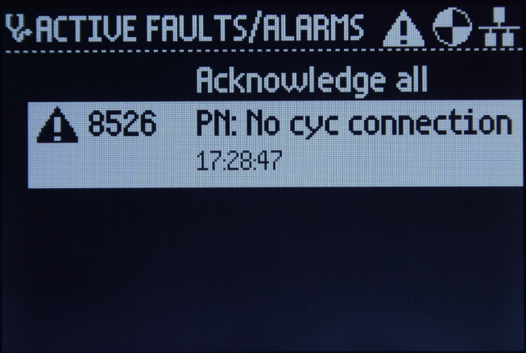
Intelligent Operator Panel
Exercise: Diagnostics – faults/alarms
In this exercise you’ll be working in the Diagnostics menu. Since an alarm is already present, this is a good time to check out the detailed help text for faults and alarms. Follow the screen shots below.
Select Diagnostics. Press OK to open the menu.
Press OK again
Select the active alarm and press OK.
First you see the Cause of the alarm. Use the wheel to scroll down and you’ll see some remedies for correcting the alarm.
INFORMATION
The Acknowledge all is for clearing faults. Faults can only be cleared after the problem is corrected. Currently there are no faults active.
Alarms however, automatically clear when the problem is corrected. Remember, we’ll clear the alarm in a later exercise. Continue to the next page.

Slide 31

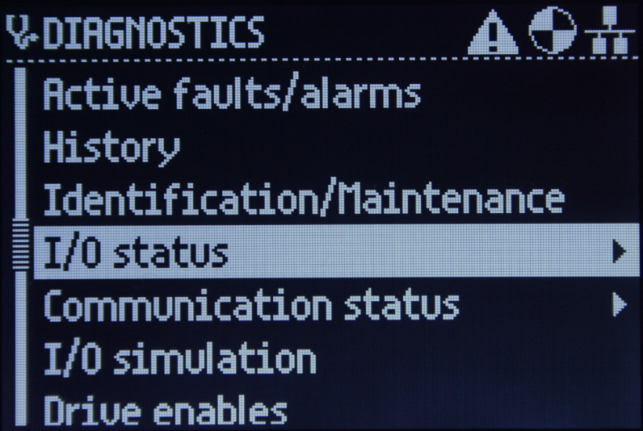
Intelligent Operator Panel
Exercise: Diagnostics – I/O status
Next, you’ll look at the I/O Status which makes diagnostics of the I/O easy and convenient. Engineers and maintenance personnel will find the I/O Status beneficial because it gives the user the ability to monitor the drive I/O without the need for a voltmeter or searching for a parameter to monitor.
Assuming you are still in the Active faults/alarms list from the previous page … follow the screen shots below.
Use the ESC button to return to this screen.
Scroll down and open the I/O Status submenu
Continue to the next page

Slide 32
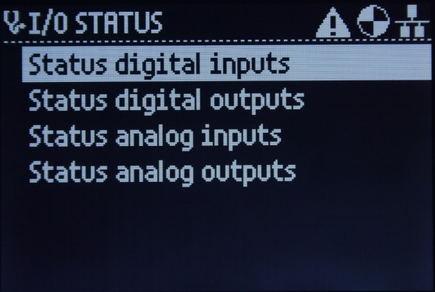
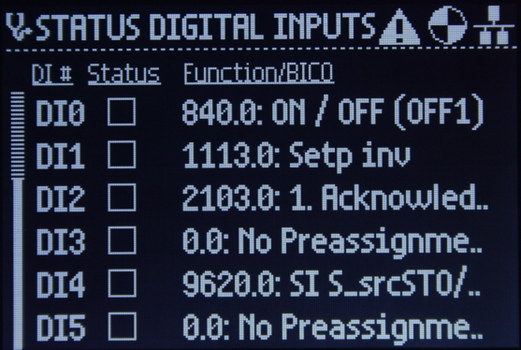
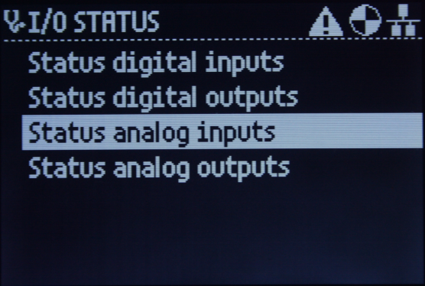
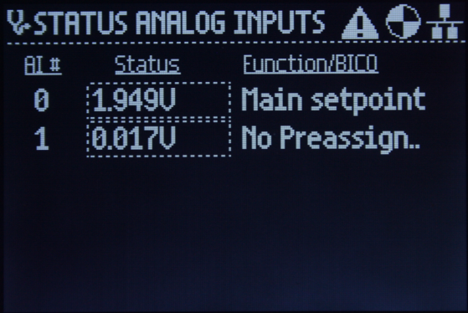
Intelligent Operator Panel
Exercise: Diagnostics – I/O status
Below are screen shots of the I/O Status submenus. Notice the icon in the top-left corner.
Take a moment to investigate the status screens of the digital inputs and analog inputs as seen in these pictures. Toggle the switches and adjust POT_1 (AI0) while you monitor the screen.
Continue to the next page

Slide 33
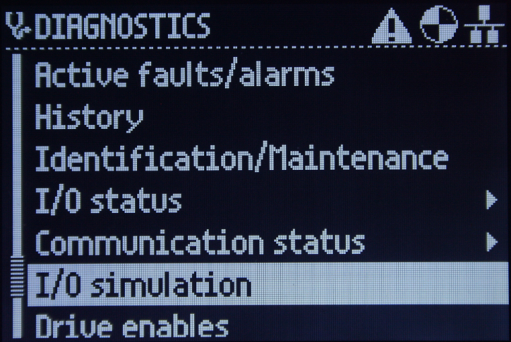
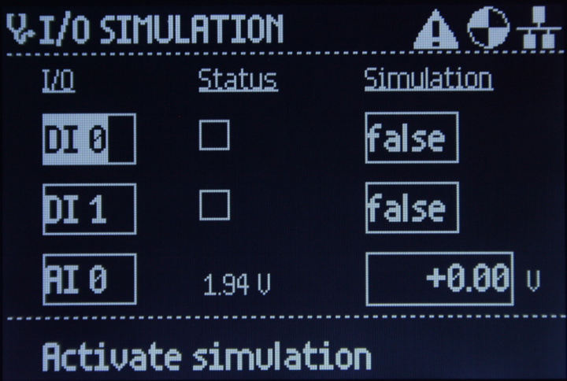
Intelligent Operator Panel
Information: Diagnostics – I/O simulation
The last of the diagnostic tools to review is the I/O Simulation. There is no exercise for this tool, just a brief explanation.
Most technical personnel who work with automation are familiar with the force function in a PLC. It is generally used in the start up phase of a machine or process. It is also handy when troubleshooting problems.
The SINAMICS G120 has this same capability. The screenshots below show how to access the I/O Simulation screen.
Here’s how it works … the user can select and configure 2 discrete I/O points and 1 analog point. By acknowledging the Activate simulation, those points are forced to the simulation value.
The Activate simulation changes to Deactivate simulation and when acknowledged, the forcing is stopped.
Before continuing to the next page, use the ESC button to return back to the top level Menu.

Slide 34
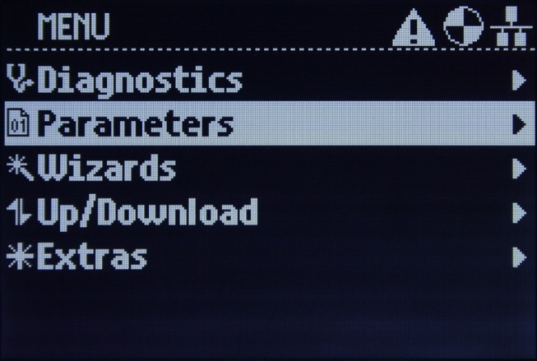
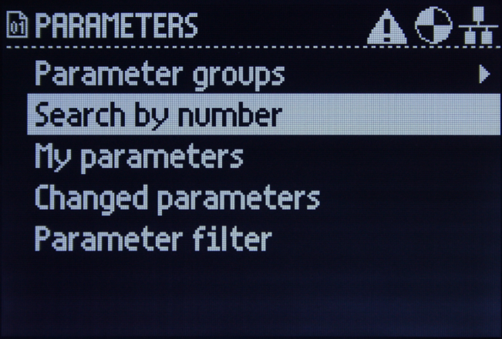
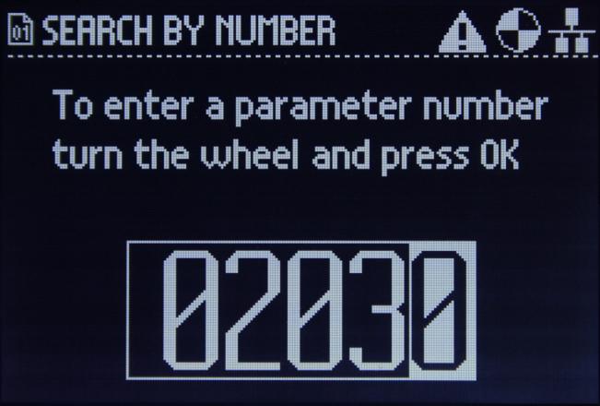
Intelligent Operator Panel
Exercise: Search function
Next you will deactivate the fieldbus port alarm. During this exercise you will learn how to use the Search function. With this tool you can quickly find the parameter you need without scrolling through the complete list.
Following the screenshots below to search for parameter 2030. After you dial in 02030, press OK and continue to the next page.

Slide 35
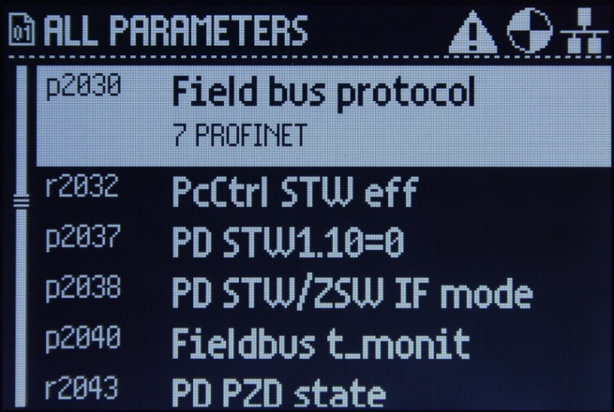
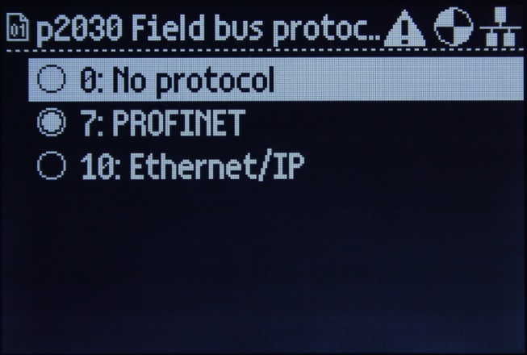
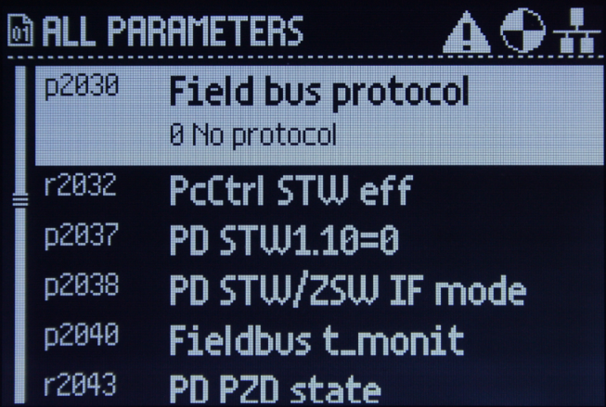
Intelligent Operator Panel
Exercise: Clearing fieldbus alarm
As you can see, the search function took you directly to parameter P2030. This method is much faster than starting at the top of the list and scrolling down.
Continue with the procedure for changing P2030. Follow the screenshots below.
Look at your drive screen closely and make sure p2030 is set to 0:No protocol like the 3rd picture above.
Changes to this parameter are only effective after a power on; therefore, you need to cycle the AC power. The switch is located on the back of the demo. Powering off for just a few second should be sufficient.
Continue to the next page

Slide 36

Intelligent Operator Panel
Information: Clearing fieldbus alarm
After the drive completes booting up, your Status screen should look like the picture below.
No alarm icon and the middle red LED lamp is off.
Continue to the next page

Slide 37

Intelligent Operator Panel
Exercise: Programming
In this exercise you will make some parameter changes that influence the analog meter behavior.
The goal of this exercise is not to teach programming. The emphasis is on the descriptive information that the IOP provides to the user.
By this point you are probably very familiar with using the ESC button and OK wheel to navigate the menus and make changes. Therefore, the remaining exercises will have limited written instructions.
From the Status screen select Menu > Parameters > Search by number. Enter the value 00776 and press OK.
You should see this on the IOP.
Continue to the next page

Slide 38

Intelligent Operator Panel
Exercise: Programming
At the moment you are at P776 in the All Parameters list.
Press OK. Now your screen should look the same as the picture below.
Take a moment to familiarize yourself with the information regarding the parameter, then continue to the next page.
P776 sets the scaling of the AOs
This is the index number
Terminal numbers for wiring
P776 [0] = 0
The output is scaled for 0-20mA

Slide 39



Intelligent Operator Panel
Exercise: Programming
(1) Press OK
(2) Select 1: 0 … +10V as seen here and press OK
(3) Notice now that P776 [0] = 1 for 0 … +10V
Continue to the next page

Slide 40



Intelligent Operator Panel
Exercise: Programming
(1) Scroll down and select p776 [1] as seen here and press OK
(2) Select 1: 0 … +10V as seen here and press OK
(3) Notice now that P776 [1] = 1 for 0 … +10V
Continue to the next page

Slide 41
Intelligent Operator Panel
Information: Hand/Auto
Before you begin this lab, ensure the drive is stopped.
In this exercise you will activate the HAND mode with the IOP Hand/Auto button.
The HAND mode gives the user a quick and easy way of taking control of the drive with the IOP. This feature is available “out of the box”. There are no parameter changes required prior to utilizing this function. However, if the user wants to deactivate this feature for any reason, it can be done by simply changing one parameter.
Continue to the next page

Slide 42

Intelligent Operator Panel
Exercise: Hand/Auto
IMPORTANT: In HAND mode … the I (green) button starts the drive, the O (red) button stops the drive.
Press the Hand/Auto button. Ensure the Hand icon appears in the top-right corner of the Status screen
Start the drive and increase the motor RPMs by rotating the OK wheel clockwise.
In the example below a value of 55% has been dialed in with the wheel.
Continue to the next page

Slide 43

Intelligent Operator Panel
Exercise: Hand/Auto
IMPORTANT: In HAND mode … the I (green) button starts the drive, the O (red) button stops the drive.
Press the ESC button. Now you see the Control menu. Without any instructions, try changing the direction of the motor.
Continue to the next page

Slide 44


Intelligent Operator Panel
Exercise: Hand/Auto
IMPORTANT: In HAND mode … the I (green) button starts the drive, the O (red) button stops the drive.
One last thing to point out about the Control menu … if you ESC from the Control menu, the Setpoint bar will not be present on the Status screen. (Ex: A).
If you select Setpoint in the Control menu, the Setpoint bar will be present on the Status screen. (Ex: B)
Ex. A: ESC from Control menu
Ex. B: Select Setpoint in Control menu
Continue to the next page

Slide 45

Intelligent Operator Panel
Exercise: Hand/Auto
IMPORTANT: In HAND mode … the I (green) button starts the drive, the O (red) button stops the drive
When you have finished experimenting with HAND mode, be sure to ESC from the Control menu. By doing this, you will have access to the menus on the Status screen and we can move on to the final exercise.
Press the Hand/Auto button. The Hand icon should disappear and the Auto icon should be present.
Now your screen should look like the one below.
Continue to the next page

Slide 46
Intelligent Operator Panel
Exercise: Backup parameters
You’ve commissioned the drive, looked at many of the IOP features, experimented with HAND mode, and made some parameter changes.
There’s one last thing to do. You need to backup the drive parameters.
The SINAMICS G120 has built in ROM for retentive parameter backup. However, there are additional methods of storing the drive parameters.
Drive parameters can be saved on a MMC, SD card, IOP or on a PC with the use of software.
In this lab you’ll backup the parameters on the IOP.
INSTRUCTIONS
From the Status screen select: Menu > Up/Download > Upload: drive to panel > Panel parameter set 5
When the upload is complete press OK.
Return to the Status screen using the ESC button.
Continue to the next page

Slide 47
Intelligent Operator Panel
Defaulting the drive
Thank you for taking time to do the exercises in this lab. Your participation is greatly appreciated.
The instructor kindly asks for your assistance with preparing the demo for the next training session by performing the four exercises listed below.
INSTRUCTIONS:
Exercise #1: Factory reset the operator panel
Menu > Extras > Panel settings > Operator panel factory reset > Yes
Exercise #2: Factory reset the drive
Menu > Extras > Parameter settings > Drive factory reset > Yes
Exercise #3: Deleting parameter sets saved on the IOP
Menu > Up/Download > Delete panel parameter set > Panel parameter set 5
Exercise #4: Set P2030 = 7
Menu > Parameters > Search by number > enter 02030.
When the search finishes, press OK to open the parameter. Select 7: PROFINET and press OK. The save icon will appear briefly on the panel display. After the Save icon disappears from the screen, turn off the AC power. Thank you!
Continue to the next page

Slide 48

Intelligent Operator Panel
You have completed the IOP Hands–on lab
We hope you found this lab informative
Thank you for your time!

Slide 49
Startdrive – TIA Portal V13
G120 commissioning

Slide 50

Startdrive
TIA Portal V13
This lab will give you a general introduction to the Startdrive software for commissioning and programming SINAMICS drives. First you will step through an actual commissioning of a SINAMICS G120 drive. After that, you will be guided through various menus to explore some of the functions and features of Startdrive.
Through out this lab you will also be directed to explore functions in the Intelligent Operator Panel (IOP) that are similar to those found in the Startdrive software.

Slide 51
Startdrive
Lab Outline
  Create project
    Project name
  Configure device
    Add new device
    Select control unit
    Select power module
  Confirm IP address
  Setting online access
  Commissioning wizard
  Load preview
  Diagnostics
  Motor ID
  Check drive operation
  Parameter menus
    Parameter view
    Functional view
  Programming analog outputs
  Control panel
  Project backup
  Trace lab

Slide 52
Startdrive
Before you begin …
Before you begin this lab there are a few things you should know …
You will be programming a SINAMICS G120 drive using a SIMATIC Field PG. (PC)
You need to open up the Startdrive software for you to begin.
The communication hardware of the PG and drive interface have been configured.
To help make this lab more intuitive, procedural steps are numbered when possible.

Slide 53

Startdrive
Create project
The TIA Portal software is open and your PG screen should look like the one below.
Using the mouse, click on Create new project and continue to the next page.

Slide 54

Startdrive
Project name
1. Enter a Project name. MyG120 is used here but you can name it something different or use the default name if you prefer.
2. Click on Create and continue to the next page.

Slide 55

Startdrive
Configure device
OK, you just created your project. Next you need to insert and configure a drive.
Click on Configure a device, then continue to the next page.

Slide 56


Intelligent Operator Panel (IOP)
Checking hardware
In just a moment you will begin selecting the drive hardware in your Startdrive project. In this lab you will be directed to the correct selections but what if you were working on an installation that did not permit easy access to the hardware labels.
How could you quickly retrieve the hardware order numbers? With the IOP Drive Identity screen!
The IOP status screen on your demo should look like the one shown
here; however, if the menus are not visible at the bottom, simply
press the INFO button on the IOP.
Using the OK wheel, follow the path below to find the drive hardware
part numbers. Remember … rotating the wheel moves the cursor, pressing OK
acknowledges your selection.
Path: Menu > Extras > Drive identity
There is no need to record these numbers for this lab. You will be directed to the correct selections in the next steps.
For now you can leave the IOP screen at Drive Identity. It will automatically return to the status screen in a few minutes.
The Drive Identity screen provides quick and convenient access to the Control Unit and Power Module part numbers as well as version numbers. This can be most beneficial in installations where access to the hardware labels is not possible.
Menus
Continue to the next page.

Slide 57

Startdrive
Add new device
Click on Add new device then continue to the next page.

Slide 58

Startdrive
Add new device – Select drive CU
Click on the Drives icon to ensure that Drives are in the device list then continue to the next page.

Slide 59


Startdrive
Add new device – Select drive CU
Next you need to select the drive control unit (CU).
1. Open the SINAMICS G120 folder by clicking on the black arrow to the left of the folder icon.
2. In the same manner, open the Control units folder.
Remember this method of opening the hardware folders, you’ll do this again later to select the power module (PM).
Continue to the next page.

Slide 60

Startdrive
Add new device – Select drive CU
Now your screen should look just like this. Continue to the next page.

Slide 61

Startdrive
Add new device – Select drive CU
1. Select the CU240E-2 PN as shown below.
2. Confirm that 4.7.3 is selected for the Version.
Notice the Order number. It should match the CU MLFB shown in the IOP Drive Identity screen.
3. Press Add
1
2
3
Continue to the next page.

Slide 62

Startdrive
Project view
Now your screen looks like this with the control unit installed. You’ll select the power module in a moment.
Continue to the next page.

Slide 63

Startdrive
Project view – Project tree
Before you complete the configuration, take a moment to get familiar with the layout.
This slide and the next two are information only, no steps to be performed.
The left column is the Project Tree. It contains the devices and their components. In this case there is only one device … the drive. Its components or submenus are the Device configuration, Parameter, Commissioning, Diagnostics and Traces. You’ll be looking at some of these later to see what items they contain.
The Project Tree also contains a menu for configuring the online access.

Slide 64

Startdrive
Project view – Hardware catalog
The right column contains the hardware catalog. Since you’re working with a G120 drive, the only hardware to choose from are the Control units and Power modules.

Slide 65



Startdrive
Add new device – Select drive PM
Do you remember how you opened the folders to select the control unit?
Now it’s time to select the power module (PM).
1. In the Hardware catalog open the Power units folder.
2. Open the PM240 folder.
A long list of PM240s appear. (Not all are shown here)
Continue to the next page.

Slide 66

Startdrive
Add new device – Select drive PM
Select the first PM240 in the list as shown. Drag and drop it in the area beside the control unit.
Notice the Order number in the Information area below the Catalog. That number should match the PM240 MLFB shown on the IOP Drive Identity screen.
Drag and drop the PM240 here
Continue to the next page.

Slide 67

Startdrive
Add new device – Select drive PM
If the drive in your Device view looks like the one below, you successfully inserted the PM.
Continue to the next page.

Slide 68

Startdrive
Modifying views
You just completed the hardware configuration.
Let’s do some housekeeping before you commission the drive.
Click on this arrow to collapse the Hardware catalog.
If the Drive Identity screen is still visible on the IOP, use the ESC button to return to the Status screen. You will need to press it multiple times.
Continue to the next page.

Slide 69


Startdrive
Modifying views
If the Device overview is open in your project as seen here, click on this arrow to hide the overview.
Continue to the next page.

Slide 70

Startdrive
Confirm IP address
1. Move the cursor over the Ethernet port icon and simply click the left mouse button to select.
2. Select the Properties tab.
Continue to the next page.
Need to Update with V13 and CU250S-2

Slide 71

Startdrive
Confirm IP address
Next, you need to open the Properties view and confirm the IP address is correct under the General tab.
To do this, move the cursor over the black line until you see the
At that moment, press and hold the left mouse key while moving the cursor toward the top of the screen. Try to open it enough to reveal the IP address. You can also use the scroll bars to position the panels.
Continue to the next page.

Slide 72

Startdrive
Confirm IP address
The drive IP address in your configuration should match the setting shown on the right. 192.168.0.33
Finally, it’s good practice to save often with any software. So, let’s do that now. On the main menu select Save project
Continue to the next page.

Slide 73

Startdrive
Setting online access
Re-open the project tree, double click Online & diagnostics under the Drive_1 device.
In the Online Access window, set the two top drop-downs as shown.
DO NOT press the Go online button.
You will be instructed to go online later in the exercise.
Continue to the next page.

Slide 74


Startdrive
Commissioning wizard
In the Project tree, double click Parameter under the Drive_1 device.
The Parameter window will open with the Wizards tab already selected.
The other tabs, Functional View and Parameter View provide two formats for viewing parameters. We’ll take a closer look at those later in the lab.
Continue to the next page.

Slide 75

Startdrive
Commissioning wizard
Let’s continue with the Startdrive commissioning process …
Select Commissioning wizard
Continue to the next page.

Slide 76

Startdrive
Commissioning wizard
Change to Expert, click Next and continue to the next page.

Slide 77

Startdrive
Commissioning wizard
No changes, simply click Next and continue to the next page.

Slide 78


Startdrive
Commissioning wizard: Macro selection
1. Click on the drop down and select (12) as shown in the lower screen shot.
2. Click the Accept button.
Continue to the next page.

Slide 79

Startdrive
Commissioning wizard
Now your setpoints/command sources screen should look like this.
Press Next and continue to the next page.

Slide 80

Startdrive
Commissioning wizard
Select the IEC 50Hz motor as shown below.
Press Next and continue to the next page.

Slide 81

Startdrive
Commissioning wizard

Slide 82

Startdrive
Commissioning wizard
Set the ramp times as shown below.
Press Next and continue to the next page.

Slide 83

Startdrive
Commissioning wizard
For the Motor identification, make the selection as shown.
Press Next and continue to the next page.

Slide 84

Startdrive
Commissioning wizard
On the Summary page of the wizard, select Finish
Continue to the next page

Slide 85


Startdrive
Commissioning wizard
1. Select Save project on the main menu
1
2. Simply select the Drive_1 device in the Project tree by clicking on it one time. (no double click)
2
3. On the Main menu select Go online
4. Confirm you are online. The online status bar in the lower right corner should be updating.
5. Click the download icon to start the offline file transfer
Continue to the next page
3
4
5

Slide 86

Startdrive
Commissioning wizard
1. You may get this screen, Start search then Load if prompted

Slide 87

Startdrive
Load preview
In the Load preview window select Load at the bottom of the window and wait for the download to complete.
Continue to the next page.

Slide 88

Startdrive
Diagnostics
When the download completes, click the Diagnostics tab and then the Alarm display tab at the bottom of the screen.
This will reveal the alarm status of the drive. Currently A07991 is active because the drive is ready to perform a stand-still tune.
The Startdrive help files for faults and alarms can be opened by simply clicking the ? in the Help column.
Click the ? now to see the details about alarm A07991. Take a moment to look over the help text.
Leave the help file open and continue to the next page.

Slide 89

Intelligent Operator Panel (IOP)
Diagnostics – faults and alarms
Is the IOP on your drive flashing?
Here is another eye-catching feature of the IOP
You will also notice that there is an alarm icon visible on the IOP status screen.
Take a minute to look at the IOP help text for the active alarm and compare it to the Startdrive help text.
Here is the path to the active faults and alarms list.
Path: Menu > Diagnostics > Active faults/alarms
To open the alarm help text, scroll down to A7991 and press the OK button. Use the OK wheel to scroll down through the text.
When you’re finished comparing the help text, use the ESC button to return to the Status screen on the IOP and close the Startdrive help text.
Unlike faults, alarms generally don’t stop the drive and may go unnoticed. For that reason the IOP will flash to signal an alarm condition. The flashing is triggered by the initial occurrence of the alarm. The flashing can be stopped by simply pressing the INFO button or with a slight rotation of the OK wheel.
Additionally, the IOP provides detailed help text for faults and alarms. In most cases both a “Cause” and “Remedy” will be provided much like the help text in Startdrive.
Continue to the next page.

Slide 90
Startdrive
Motor ID – Standstill tune
In this step you will initiate the Motor Data ID, also called the stand-still tune. Please read the bullets below so you will know what to expect while the tuning is active.
In just a moment you will be instructed to start the drive, when you do …
You will hear the drive cooling fan running
The motor shaft might rotate ¼ turn or less
You will hear a series of high frequency rings from the motor while the Motor Data ID is in progress
Start the drive by switching S1 (DI0) ON and leave it in the ON position until the Motor Data ID has finished.
How will you know it’s finished? The drive automatically goes to an “off” state and the cooling fan stops running.
Also, the A07991 alarm will clear from the list.
After the Motor ID has finished, set S1 (DI0) back to the OFF position and continue to the next page.
Continue to the next page.

Slide 91
Startdrive
Check drive operation
Congratulations!
The commissioning is complete and the drive is ready for operation.
Take a moment to experiment with the drive controls. The table below has a description of the switch functions and the meaning of the indicator lamps. There are no faults present on the drive so, you really can’t test S3; however, we can test the input with Startdrive later in this lab. Continue to the next page when you are finished experimenting.
Switch | Function | Description
S1 (DI0) | Run / Stop | Drive enable
S2 (DI1) | Reverse | Reverse with S1 on.
S3 (DI2) | Fault reset | Toggle on-off to clear fault
Pot1 (AI_0) | Speed setpoint | Setpoint, 0 – max rpm
DO_0 | Fault indication | Lamp, On = fault
DO_1 | Alarm indication | Lamp, On = alarm
DO_2 | Drive running | Lamp On = Drive running
All other switches and the analog meters are not applicable to this exercise.

Slide 92


Intelligent Operator Panel (IOP)
Copy RAM to ROM
Look at the IOP … notice the icon in the top-right corner of the Status screen?
Why is the icon present now?
During the commissioning process you performed a motor ID tune. As a result of that process, the drive makes some calculations and parameter modifications. Those changes are made in RAM only.
There is no need to be concerned about the presence of the save icon at this time. You will be instructed to do a project backup later in this lab.
However, if you want to activate the copy RAM to ROM now with the IOP, follow the path below.
Path: Menu > Extras > Parameter settings > Save RAM to ROM > Yes
When the save is complete, use the ESC button to return to the Status screen.
The (Save) icon indicates when data saved in RAM differs from data saved in ROM. It is normal for the icon to briefly appear when changing parameters with the IOP because with each change, a copy RAM to ROM is automatically executed.
However, with Startdrive parameter changes take place only in RAM and the backup to ROM must be manually activated.
Continue to the next page.

Slide 93



Startdrive
Parameter menus
Since you’re already in the Parameter folder, now is a good time to look at the different views available to the user for monitoring and modifying parameters.
1. Click this arrow to collapse the properties field in the lower part of the work area. This will free up viewing space.
2. Select the Parameter View tab in the upper right corner.
3. Click on the drop down to open this field. Change it to Display extended parameters
4. Select All Parameters
Continue to the next page.

Slide 94


Startdrive
Parameter View
Scroll down the All parameters list. I’m sure you’ll agree … that’s a lot of parameters!
With all those parameters, it makes good sense to organize them in categories based on function. Next you will take a closer look at a few of those categories in both the Parameter View and Functional View.
First, let’s look at some of the I/O in the Parameter View.
1. Open the Inputs/outputs by clicking on the black arrow.
2. Select the Digital inputs as shown.
Continue to the next page.

Slide 95
Startdrive
Parameter View – Extended parameters
Before proceeding with the lab, Lets show all the parameters we can
The Go online and Go offline tools are used for establishing and disconnecting communications between the programming device (PG/PC) and the drive.
The online view and offline view are used to control the live updating of the active page (screen) in the work area.
The explanation of online view and offline view continues on the next page.

Slide 96


Startdrive
Parameter View – Online vs Offline
Below are two examples of the same data fields. The top one is with Online view active and the bottom is with Offline view active. Notice that the fields in the value column are highlighted in the Online view.
Online view
Value column
Offline view
Continue to the next page.

Slide 97

Startdrive
Parameter View – Digital inputs
Now that you know how to properly monitor data online, let’s continue looking at some of the parameters in the Parameter View.
Look at r722. It is a word that represents the status of the digital inputs as a whole. Toggle some of the demo switches and you will see this value change.
Click on the arrow beside r722 to reveal the individual bits that make up the r722 word. What you see are the digital input status bits. Toggle some of the switches again to see what happens.
Continue to the next page.

Slide 98


Startdrive
Parameter View – Analog inputs
Next let’s look at the Analog inputs. Select the Analog inputs in the Inputs/outputs parameter group as shown here.
Click on the arrow beside r755 to reveal the process values of analog input 0. (AI0, AI1 is not connected).
Adjust the potentiometer on the demo and monitor the percent value in the right-hand column.
What you are seeing is a 0 – 100% representation of the 0 – 10V signal coming in on AI0 . Also, the information in the description column tells you that the electrical signal wires for the analog inputs are connected to terminals 3&4 (AI0 T. 3/4).
Continue to the next page.

Slide 99


Startdrive
Parameter View – Speed setpoint
Finally, in the Parameter View let’s look at some parameters in the Speed setpoint channel.
Locate the Setpoint Channel group just below the Inputs/outputs.
Open the group by clicking on the arrow and then select Speed setpoint as shown here.
Start the drive by placing S1 (DI0) in the ON position. While monitoring the values in the Speed setpoint group, vary the speed and direction of the motor with Pot1 (AI_0) and S2 (DI1) to see what changes.
Continue to the next page.

Slide 100
Startdrive
Parameter View – Summary
Obviously monitoring parameters in the Parameter View is not the most intuitive for the novice.
However, for the experienced engineer or maintenance technician, the Parameter View provides a great deal of drive data in a single parameter group.
Next we’ll look at these same parameter groups in the Functional View.

Slide 101

Startdrive
Functional View – Digital inputs
The Functional View provides the user with a graphical representation of the parameter functions.
In the Work area select the Functional View tab.
Locate and open the Inputs/outputs group.
Select the Digital inputs.
Continue to the next page.

Slide 102

Startdrive
Functional View – Digital inputs
Once again toggle some of the switches on the demo while monitoring the input fields. Is this more intuitive?
Continue to the next page.

Slide 103

Startdrive
Functional View – Digital inputs
Simulation
In the G120 the user has the ability to do I/O simulation with both Startdrive and the IOP. Basically this is the equivalent of doing a force of the I/O in a Programmable Logic Controller (PLC).
1. Notice the Terminal evaluation field for DI0. Click on the drop down and select Simulation.
2. With Simulation active, this box becomes visible.
Warning: The next step will enable the drive and the motor may rotate depending on the setting of Pot1. Make sure all objects are clear of the motor shaft.
3. Hover the cursor over the box. It will change colors. Click on the box to select. Did the drive enable?
4. Uncheck the box to stop the drive and change the drop down back to Terminal evaluation.
Continue to the next page.

Slide 104
Intelligent Operator Panel (IOP)
I/O Status & I/O Simulation
Here is the path to the I/O Status screen.
Path from the Status screen … Menu > Diagnostics > I/O status > Select the I/O type to monitor
Take a moment to investigate the I/O Status screen. When you’re finished, use the ESC button to return to the Status screen.
Continue to the next page for more details concerning the I/O Simulation.
The IOP also has diagnostic screens for monitoring the I/O status and I/O simulation. Commissioning engineers and maintenance personnel will find both of these features very useful during start-ups and for troubleshooting problems.

Slide 105





Intelligent Operator Panel (IOP)
I/O Simulation
Here is the path to the I/O Simulation screen.
Path from the Status screen … Menu > Diagnostics > I/O simulation
The IOP screen shots below are an example of how to setup I/O simulation. Configure and activate the simulation as shown or select other I/O points if you wish. Monitor the I/O status in Startdrive.
The OK wheel is used to adjust and select each field.
NOTICE: The I/O Simulation makes parameter changes in RAM. You will see the Save icon appear on the screen.
Be sure to Deactivate simulation when you are finished and use the ESC button to return to the Status screen.
Continue to the next page.

Slide 106

Startdrive
Functional View – Analog inputs
Next, select the Analog inputs under the Inputs/outputs group. Adjust the potentiometers on the demo while monitoring the voltage and percentage fields. You can monitor these values with the drive stopped.
Terminal
numbers
Voltage level
of input signal
Click on this box to see what it reveals.
Percentage of
0 – 10V input
Destination of input
signal – Main setpoint
Continue to the next page.

Slide 107

Startdrive
Functional View – Speed setpoint
Finally, let’s look at the Speed setpoint in the Setpoint channel group. Hover the mouse over some of the highlighted fields to see what information is provided. Also, click on the boxes to see if they act as links to other parameter groups. When you’re finished exploring the setpoint channel, continue to the next page.

Slide 108


Startdrive
Control panel
Next we will look at the Startdrive Control Panel. This feature allows the user to take control of the drive via the software without the necessity of changing any drive parameters.
In the Project tree, double click Commissioning under the Drive_1 device.
In the work area, select Control panel.
Continue to the next page.

Slide 109

Startdrive
Control panel - Activation
Follow the numbers below for the sequence to activate the control panel.
1: Enter monitoring time = 3000 and press continue
2: 1=Start
3: Enter a speed
4: Select a direction
Continue to the next page.

Slide 110
Startdrive
Control panel - Deactivation
Follow the numbers below for the sequence to deactivate the control panel.
3: Deactivate and press continue
2: Reset enables
1: 0=Stop
Continue to the next page.

Slide 111

Intelligent Operator Panel (IOP)
HAND Mode
The next few pages explain how to use the HAND mode.
The HAND mode of the IOP gives the user a quick and easy way of taking control of the drive with just a touch of a button. This feature is available “out of the box”. There are no parameter changes required prior to utilizing this function. However, if the user wants to deactivate this feature for any reason, it can be done by simply changing one parameter. The HAND mode allows the user to start/stop the drive, jog the motor, change direction and vary the speed setpoint. All this control with no control wires attached.
Continue to the next page.

Slide 112

Intelligent Operator Panel
Exercise: Hand/Auto
IMPORTANT: In HAND mode … the I (green) button starts the drive, the O (red) button stops the drive.
Press the Hand/Auto button. Ensure the Hand icon appears in the top-right corner of the Status screen
Start the drive and increase the motor RPMs by rotating the OK wheel clockwise.
In the example below a value of 55% has been dialed in with the wheel.
Continue to the next page

Slide 113
Intelligent Operator Panel
Exercise: Hand/Auto
IMPORTANT: In HAND mode … the I (green) button starts the drive, the O (red) button stops the drive.
Press the ESC button. Now you see the Control menu. Without any instructions, try changing the direction of the motor.
Continue to the next page

Slide 114


Intelligent Operator Panel
Exercise: Hand/Auto
IMPORTANT: In HAND mode … the I (green) button starts the drive, the O (red) button stops the drive.
One last thing to point out about the Control menu … if you ESC from the Control menu, the Setpoint bar will not be present on the Status screen. (Ex: A).
If you select Setpoint in the Control menu, the Setpoint bar will be present on the Status screen. (Ex: B)
Ex. A: ESC from Control menu
Ex. B: Select Setpoint in Control menu
Continue to the next page

Slide 115

Intelligent Operator Panel
Exercise: Hand/Auto
IMPORTANT: In HAND mode … the I (green) button starts the drive, the O (red) button stops the drive
When you have finished experimenting with HAND mode, be sure to ESC from the Control menu. By doing this, you will have access to the menus on the Status screen and we can move on to the final exercise.
Press the Hand/Auto button. The Hand icon should disappear and the Auto icon should be present.
Now your screen should look like the one below.
Continue to the next page

Slide 116

Startdrive
Project backup
You are close to the end of this lab so, the next thing to do is backup the project.
1. Select Save/Reset under Commissioning.
2. In the Save RAM data to EEPROM menu, press the Save button.
With that, changes on the drive have been backed up, but the project needs to be saved on the PG.
Continue to the next page.

Slide 117

Startdrive
Project backup
The offline file on the PG needs to be updated with the changes made in the drive.
1. On the Main menu, select Go offline. You may need to click on the Drive_1 device in the Project tree to activate this button.
2. A dialog box will open asking if you want to save RAM to EEPROM. You did this save on the previous page but you can do it again if you like.
3. Click the Load from device button. You may need to click on the Drive_1 device in the Project tree to activate this button.
4. In the Upload Preview window check the Upload box in the shaded area, then press the Upload from device button at the bottom of the preview window.
5. Press the Save project on the Main menu.
Continue to the next page.

Slide 118
Startdrive
TIA Portal V12
You have completed the primary portion of the
Startdrive Hands–on lab.
The next lab focuses on the Trace function.

Slide 119


Startdrive
Trace function: Open trace tool
In this lab you will do a simple exercise that will introduce you to the trace function. The trace function allows the user to record process data in the drive and display that data in a graphical representation for analysis.
In the Project tree double click on Add Trace under the Drive_1 device.
Double click on Trace and the display will open in the Work area as shown here.
Continue to the next page.

Slide 120

Startdrive
Trace function: Select signals
Under the General tab, open the Configuration and select Signals.
The Signals is a table of parameters to be monitored in the trace.
Clicking on this icon opens a list of parameters for you to choose from.
Continue to the next page for the list of parameters you need to select for the Signals table.

Slide 121

Startdrive
Trace function: Select signals
Select the following parameters for the Signals table …
Name Address
Speed actual value, Smoothed with P0045 r63[1]
CU analog inputs actual value in percent r755[0]
Absolute current actual value, Smoothed with p0045 r68[1]
Continue to the next page.

Slide 122

Startdrive
Trace function: Recording conditions
Next, select Recording conditions under the General tab.
Here is where you configure the trigger that starts the trace recording.
Notice the default trigger is to Start recording immediately.
You will change the trigger on the next page.
Continue to the next page.

Slide 123

Startdrive
Trace function: Trigger
1. In the Trigger field, click on the drop-down and select Trigger on tag.
2. Next, simply click on the entry in the Tag field. You will notice it becomes highlighted. Press the delete key to delete the data.
3. Once this is done, a box will open allowing you to select another tag.
Scroll down the list, locate and select CU digital inputs status r722.
Set bit 2 of Byte 0 = 1
Continue to the next page.

Slide 124
Startdrive
Trace function: Cycle time
1. Set the Cycle time to 5
2. Set the Duration to 10000.0
3. Set the Pretrigger to 2000.0
Continue to the next page.

Slide 125
Startdrive
Trace function: Configuration transfer
The trace is configured and now you need to transfer the configuration to the drive but first, save the project!
Next, select the Drive_1 device in the Project tree.
Press Go online on the tool bar.
In the toobar for the trace area, click on the transfer icon. This will load the configuration in the drive.
Continue to the next page.

Slide 126

Startdrive
Trace function: Trace activation
1. Start the drive with S1 and adjust the speed setpoint (Pot1) to approximately 100 RPMs.
2. Read all the instructions in this step before you do it!
Next, Switch S3 to the ON position and without delay, quickly adjust Pot1 to the maximum speed setpoint (full clockwise rotation) and observe the trace status in the Trace Handling field!
When the trace has finished recording, the data will automatically be uploaded to the PG and displayed.
Continue to the next page.

Slide 127

Startdrive
Trace function
Your trace may look similar to the one shown.
When the trace has finished recording, the data will automatically be uploaded to the PG and displayed.
Continue to the next page.

Slide 128
Startdrive
TIA Portal V13
You have completed the
Startdrive Hands–on lab
We hope you found this lab informative.
Thank you for your time!

